Slide 1
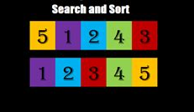
M02 L07 TDD and Search Algorithms

Slide 2
Check In
Quiz 01
GE01 Feedback and Solution will be given in an announcement this weekend.
Career Prep - Workshops will be announced to draft resume
Sep 25 STEM Career Fair Fall 2025
Speaker September 30th
Job & Internship Fair 2025
Goals
Visualize a problem and apply TDD to come up with an algorithm for sorting and searching
Use Java Arrays methods
Set Up
Open SelectionSortTDD.java from last class

Slide 3
Problem Solving and Test Driven Development
Write a Visualization of the problem
Use TDD to come up with varied test cases.
Write down the method signature (name, parameters, return)
Brainstorm ideas of the algorithm in pseudocode for the first step
Implement one algorithm in the method and unit test that the code works for the first step
Repeat this process
Refactor your code to improve how it is written

Slide 4
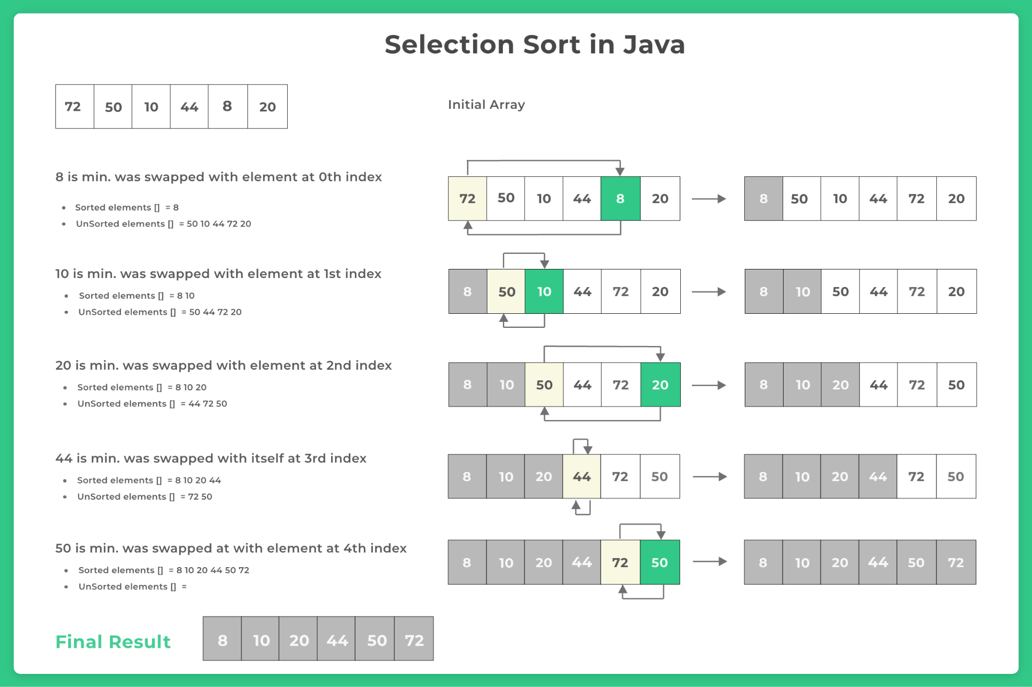
Problem Solving with Visuals to Sort 1D Array Small to Large
0
1
2
3
4
5
Close computer and put your name on paper.
Brainstorm ideas by writing visuals of the steps to order the items from smallest to largest.

Slide 5

Find Index of Smallest Algorithm and Test
Test Driven Development: Focus on first step in your plan that you visualized. Design algorithm with pseudocode to find smallest
0
1
2
3
4
5
Case | Precondition | Postcondition
Regular | {4, 2, 7, 1, 5} | {2, 4, 7, 1, 5}
Empty | {} | {}
Single Element | {5} | {5}
Already Sorted | {1, 2, 3, 4, 5} | {1, 2, 3, 4, 5}
Reverse Sorted | {9, 7, 5, 3, 1} | {7, 9, 5, 3, 1}
Array with duplicates | {4, 2, 7, 2, 5} | {2, 4, 7, 2, 5}
After you have an idea for the aglorithm talk to the rubber ducky to see if it works for the varied test cases. Today you can also talk to your partner.
Then you would implement the code and test with the different test cases.

Slide 6
Swap Values and Test
Focus on the next step to swap if neccessary
0
1
2
3
4
5
Case | Precondition | Postcondition
Regular | {4, 2, 7, 1, 5} | {2, 4, 7, 1, 5}
Empty | {} | {}
Single Element | {5} | {5}
Already Sorted | {1, 2, 3, 4, 5} | {1, 2, 3, 4, 5}
Reverse Sorted | {9, 7, 5, 3, 1} | {7, 9, 5, 3, 1}
Array with duplicates | {4, 2, 7, 2, 5} | {2, 4, 7, 2, 5}

Slide 7
Algorithm to Repeat Steps for Smaller Array and Test
Focus on the next step to repeat with remaining part of the array
Case | Precondition | Postcondition
Regular | {4, 2, 7, 1, 5} | {2, 4, 7, 1, 5}
Empty | {} | {}
Single Element | {5} | {5}
Already Sorted | {1, 2, 3, 4, 5} | {1, 2, 3, 4, 5}
Reverse Sorted | {9, 7, 5, 3, 1} | {7, 9, 5, 3, 1}
Array with duplicates | {4, 2, 7, 2, 5} | {2, 4, 7, 2, 5}
0
1
2
3
4
5

Slide 8
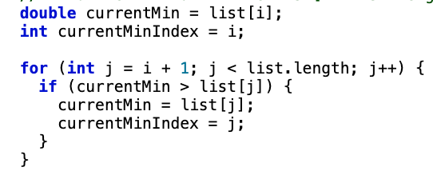

Selection Sort Steps
for (int i = 0; i < list.length - 1; i++) {
Outer for loop 0 to index 5
0
1
2
3
4
5
Inner for loop sublist
0 - 5
Inner for Finds smallest element in sublist
1 - 5
2 - 5
Swaps list[i] with list[currentMinIndex] unless i and currentMinIndex are the same
3 -5
4-5

Slide 9

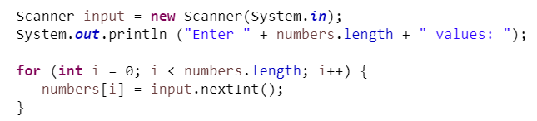
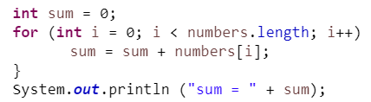
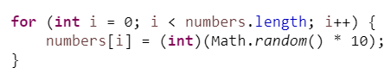
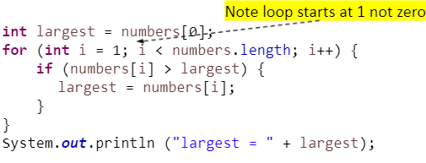
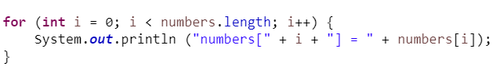
Review CS1050 Algorithms for Processing Arrays
Initialize with input values
Sum Elements
Initialize with random values
Find largest element
Display Array

Slide 10

Problem Solve Searching Algorithms
Write a Visualization of the problem
Use TDD to come up with varied test cases.
Write down the method signature for sort (name, parameters, return)
Brainstorm ideas of the algorithm in pseudocode for the first step
Implement one algorithm in the method and unit test that the code works for the first step
Repeat this process
Refactor your code to improve how it is written

Slide 11
Searching and Sorting Algorithms
Brainstorm ideas on paper to help come up with ideas for an algorithm to do the following.
How would you approach sorting the integers in the array from smallest to largest?
How would you approach searching the array for the number 36?
Use test driven development to come up with varied test cases in a table
Test Case | precondition | Action | postcondition

Slide 12
Linear Search Visually
Linear search Visualization
What do you notice about this array?
What about the efficiency of this search?
How would you approach searching in a sorted array?

Slide 13
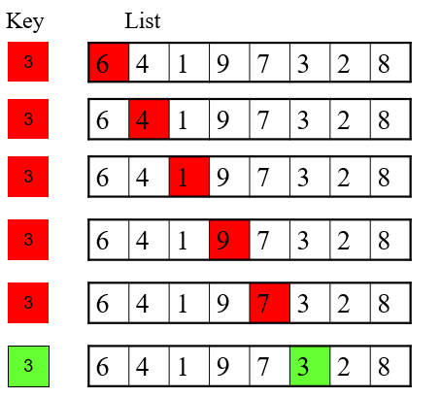
Linear Search (also called Sequential Search
Starting at beginning of an array and looking for a specific value one element at a time
When a match is found that index of the match is returned, otherwise a -1 is returned
The elements in the array are in any order
Not very efficient algorithm - execution time grows linearly as the array size grows!
Best case: 1st element is key we are looking for
Worst case: last element is key or doesn't find key
Average: 50% of elements are examined before key is found

Slide 14
Searching Arrays: Linear
Searching is the process of looking for a specific element in an array; for example, discovering whether a certain score is included in a list of scores. Searching is a common task in computer programming.
There are many algorithms and data structures devoted to searching. First let's look at the linear search.
Explore how the linear searchworks
LinearSearch code animation
public static int linearSearch(int[] list, int key) {
for (int i = 0; i < list.length; i++) {
if (key == list[i])
return i;
}
return -1;
}
It is generally not good practice use a return in a for loop. One exception is searching. In this case do not want to keep searching when the list can be very large so notice the two returns.
Why return -1?

Slide 15
Binary Search
Binary Search is another approach but it requires that the elements in the array be ordered before the search begins
Binary search Visualization
Write a Visualization of the problem - what are the steps?
Use TDD to come up with varied test cases.
Write down the method signature for sort (name, parameters, return)
Brainstorm ideas of the algorithm in pseudocode for the first step
Implement one algorithm in the method and unit test that the code works for the first step. Add this to your code from last class.
Repeat this process
Refactor your code to improve how it is written

Slide 16
Binary Search
Binary Search is another approach but it requires that the elements in the array be ordered before the search begins
Algorithm:
Starts with element in the middle of the array
If key is less than "middle" element, then only search for key in 1st half of array
If key is equal to "middle" element, return match!
If key is greater than "middle" element, then only search for key in 2nd half of array
When a match is found that index of the match is returned, otherwise a -1 is returned
More Efficient algorithm - array shrinks by 50% after each comparison!

Slide 17
// 🔹 Unsorted Array - Best for Linear Search
int[] unsortedArray = {42, 7, 89, 3, 23, 12, 36, 5};
// linearSearch(unsortedArray, 36); // Middle case
// linearSearch(unsortedArray, 7); // Best case (near start)
// linearSearch(unsortedArray, 99); // Worst case (not found)
// 🔹 Sorted Array - Best for Binary Search
int[] sortedArray = {3, 5, 7, 12, 23, 36, 42, 89};
// ✅ Example searches:
// binarySearch(sortedArray, 36); // Middle element (best case)
// binarySearch(sortedArray, 89); // Last element (worst case)
// binarySearch(sortedArray, 50); // Not found (worst case)

Slide 18
// 🔹 Edge Cases
int[] emptyArray = {}; // Searching an empty array should return -1
int[] singleElementArray = {10};
// ✅ Example searches:
// binarySearch(singleElementArray, 10); // Found at index 0
// binarySearch(singleElementArray, 5); // Not found
int[] allSameValues = {4, 4, 4, 4};
// ✅ Example searches:
// binarySearch(allSameValues, 4); // Returns any valid index
// binarySearch(allSameValues, 3); // Not found (-1)
int[] hasDuplicates = {3, 5, 7, 7, 7, 12, 23, 36};
// ✅ Example searches:
// findFirstOccurrence(hasDuplicates, 7); // Should return index 2
// findLastOccurrence(hasDuplicates, 7); // Should return index 4
Next Lecture we will discuss finding indexes for duplicate

Slide 19
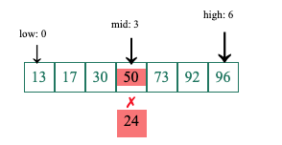
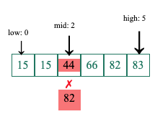
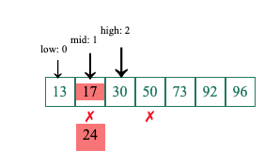
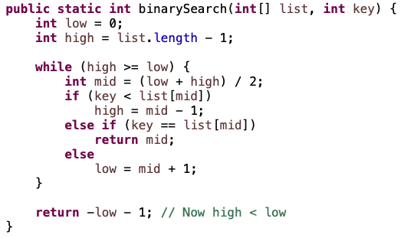
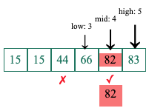
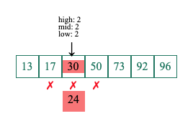
Searching Arrays: Binary
mid = (low + high)/2
3 = (0 + 6) /2
mid = (low + high)/2
2 = (0 + 5) /2
The binary search method works on sorted arrays by repeatedly dividing the search interval in half until the target value is found or the interval is empty. Again since doing a search it is ok to return from with in the while loop if found.
mid = (low + high)/2
3 = (0 + 2) /2
mid = (low + high)/2
4 = (3 + 5) /2
Integer division to find middle
found
not found 0-1
Returns -1
Not found

Slide 20
Linear vs Binary Search
Linear Search
Search algorithm in which each item in the list is compared to a specific key starting at the beginning and comparing the key with each element sequentially.
Binary Search
Searching a pre-sorted array by splitting the array in half on each comparison.
Linear search is good for:
Small arrays
Unsorted arrays
Binary search is good for:
Large arrays that are presorted

Slide 21


Arrays Class
There are many tasks that are useful when working with arrays. Java provides an Arrays class that includes static methods for searching, sorting, filling, comparing, etc.
Just like the Math class was different, so is the Array class! You do not need to create a method
Unlike the Scanner class where you must create an object
How can we use the Math or Array class if we cannot create a Math or Array object?
Because ALL methods in the Math and Array class are what we called static methods
Static methods
Allow you to call the methods in a class without creating an object of the class
Are NOT associated with a specific object of the class
To call static methods you use the class name
These are similar to the static methods you create in your class
double squareRoot = Math.sqrt(25);
Arrays.fill (myNewArray, 10);

Slide 22

Math and Arrays Class Examples
// Fill an array with random values and sort
for (int i = 0; i < myNewArray.length; i++) {
myNewArray[i] = (int)(Math.random() * 100);
}
Arrays.sort(myNewArray);
Math Class allows you to call the static methods without creating an Object. In this case calling the random() method
What does it mean if it is a static method?
import java.util.Scanner;
import java.util.Arrays;
// Using Arrays class
Import Arrays Class
int [] myNewArray = new int[10];
Arrays.fill(myNewArray,13);
Arrays Class allows you to call the static methods without creating an Object. In this case calling the fill method. But the array is passed to the method.
How is the array passed to the Arrays.fill method?

Slide 23
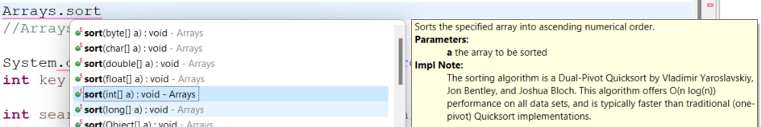
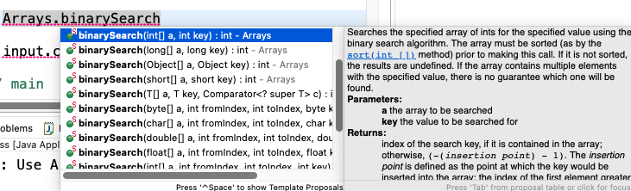
The Arrays Class Sort and Binary Search Method
Since sorting is frequently used in programming, Java provides several overloaded sort and search methods for working with different data types int, double, char, short, long, and float.
How will the array be passed to this method?
What must be done to the array before using binarySearch? What is passed and what is returned?

Slide 24
Sorting Arrays
Review Bubble and Selection sort. Discuss the algorithms used
Selection sort - Sorting algorithm in which each value, one at a time, is placed into its final sorted position in the list.
Bubble sort - Sorting algorithm in which values are repeatedly compared to neighboring elements in the list and their positions are swapped if they are not in the correct order relative.
Insertion sort - Sorting algorithm in which each value, one at a time, is inserted into a sorted subset of the entire list.
Quick sort - Will discuss when cover recursion
Merge sort - - Will discuss when cover recursion

Slide 25
Resources and Prepartion
More Resources
Sorting Animation
5.7 The Bubble Sort
5.8 The Selection Sort
5.9 The Insertion Sort
Practice and Summarize
Use TDD to design algorithms and implement code one step at a time to search and sort
Implement the Arrays Class to search and sort
Update Tech Doc for M02

